Slide 1
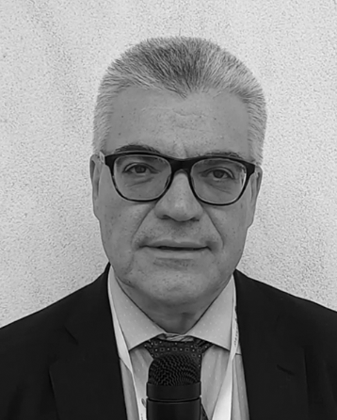
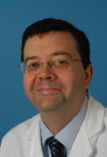
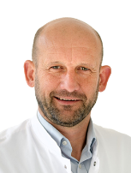
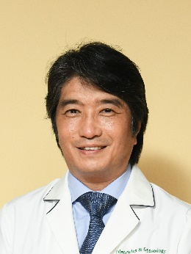
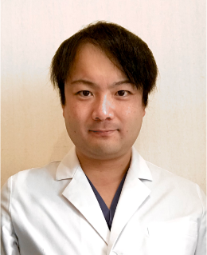
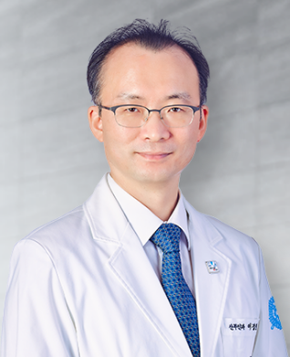
Asian Society of Gynecologic Oncology
Education Committee
ASGO Webinar Series #49
ASGO - ESGO 1st Joint Webinar
Title
ESGO new guideline for the AYA GYN cancer patients
Moderator
Speaker
Discussant
Alexandros Rodolakis
National & Kapodistrian University of Athens
Greece
Philippe Morice
Institut Gustave Roussy
France
Frédéric Amant University Hospitals of Leuven
Belgium
The Asian Society of Gynecologic Oncology (ASGO) and the
European Society of Gynaecological Oncology (ESGO) are excited to announce the first joint webinar on fertility preservation in gynecologic cancers. With rising cases in younger populations, this topic is increasingly critical. Leading experts, including Alexandros Rodolakis, Philippe Morice, and Frédéric Amant from ESGO, and Nao Suzuki, Masato Yoshihara, and Jung Ryeol Lee from ASGO, will share their insights and engage in lively discussions. Participants will have the chance to learn about the latest advancements and ask questions during the Q&A session. This collaboration aims to foster deeper cooperation and innovation in the field, providing a platform for valuable knowledge exchange. We invite everyone to attend, gain insights from top specialists, and contribute to advancing gynecologic oncology. Don’t miss this unique opportunity to enhance your
understanding and practice. Join us for this important event.
Title
Impact of Fertility Preservation on Ovarian Cancer
: Clinical Analysis and Current Understandings in Asia
Moderator
Speaker
Discussant
Nao Suzuki
St. Marianna University School of Medicine
Japan
Masato Yoshihara
TOYOTA Memorial Hospital
Japan
Jung Ryeol Lee Seoul National University Bundang Hospital
South Korea
Jun 20, 2024 (Thursday) at 19:00 KST
Jun 20, 2024 (Thursday) at 19:00 KST
Please check your local time below.

